Slide 1
Analysis of Batch Normalization paper

Slide 2
Table of Contents
Problem Statement
Current Approach
Experimentation
Results
Limitations

Slide 3
Problem Statement
The paper tries to solve following problems:
Internal Covariate Shift
Convergence of the model

Slide 4
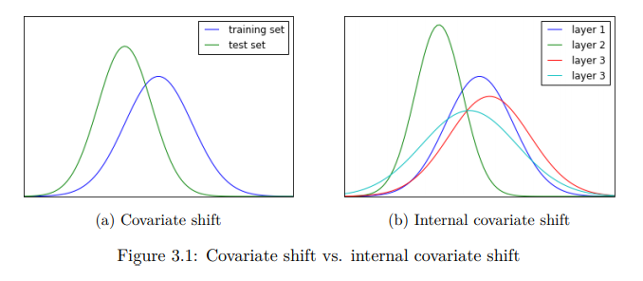
Internal Covariate Shift
Change in the distribution of network activations due to the change in network parameters during training
When input distribution changes, hidden layers try to learn to adapt to the new distribution.

Slide 5
Current Approach - Mathematical Formulation
A simple network is considered as:
ℓ = F2(F1(u, Θ1), Θ2)
where F1 and F2 are arbitrary transformations, and the parameters Θ 1 , Θ 2 are to be learned to minimize the loss ℓ.

Slide 6
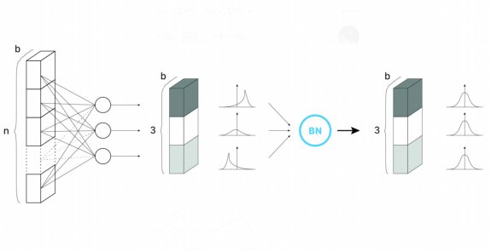
Current Approach: Architecture
Image: Batch Normalization Architecture with batch size =3

Slide 7
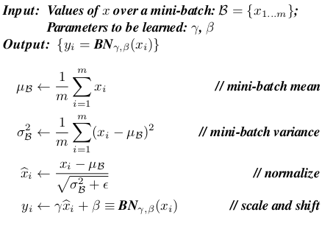
Current Approach: Algorithm
Algorithm 1 Batch Normalizing Transform, applied to activation x over a mini-batch(Forward Propagation).

Slide 8
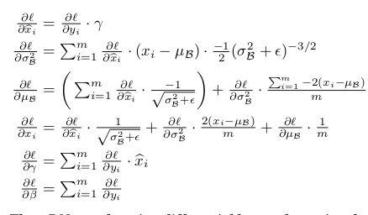
Current Approach: Algorithm
Algorithm 1 Batch Normalizing Transform, applied to activation x over a mini-batch(Backpropagation)

Slide 9
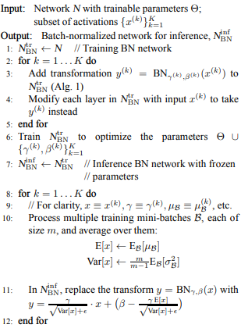
Current Approach: Algorithm
Algorithm 2 Training a Batch-Normalized Network

Slide 10
Current Approach: CNNs
BN can be applied to CNNs
z = g(Wu + b)
add the BN transform immediately before the nonlinearity, by normalizing x = Wu+ b
we normalize Wu+b, the bias b can be ignored since its effect will be canceled by the subsequent mean subtraction (the role of the bias is subsumed by β
For convolutional layers, we additionally want the normalization to obey the convolutional property – so that different elements of the same feature map, at different locations, are normalized in the same way. To achieve this, we jointly normalize all the activations in a minibatch, over all locations.

Slide 11
Experiments: Activations over time
Problem : predicting the digit class on the MNIST dataset
Dataset: MNIST
Input: 28*28 binary image

Slide 12
Experiments: Activations over time
performed to verify the effects of internal covariate shift and batch normalization ability to tackle it in problem of predicting digits classes.
Preprocessing:
No significant processing steps have been mentioned in the paper for this experiment

Slide 13
Experiments: Activations over time
Loss Function:
Cross entropy was used as loss function.
Hyperparameters Used:
Mini batch size = 60
Training Steps = 50,000
Network Configuration:
3 fully connected hidden layers with 100 activations each and last fully connected layer with 10 activations.
Evaluation Metric:
Cross entropy loss and accuracy

Slide 14
Experiments: ImageNet Classification
Batch Normalization was applied to a new variant of inception network which was trained on ImageNet classification task.
Dataset:
Imagenet Classification dataset.
Preprocessing:
Preprocessing of dataset is not mentioned in this paper, but several modifications were made in the network.

Slide 15
Result
Comparison:
Batch normalized network had higher test accuracy.
It was also seen for the original network without batch normalization input distribution changed significantly over time both in their mean and variance which complicated the training process but in case of batch normalized network, this distribution was more stable as the training progressed which aided in training.

Slide 16
Result
Comparison:
Batch normalized network had higher test accuracy.
It was also seen for the original network without batch normalization input distribution changed significantly over time both in their mean and variance which complicated the training process but in case of batch normalized network, this distribution was more stable as the training progressed which aided in training.

Slide 17
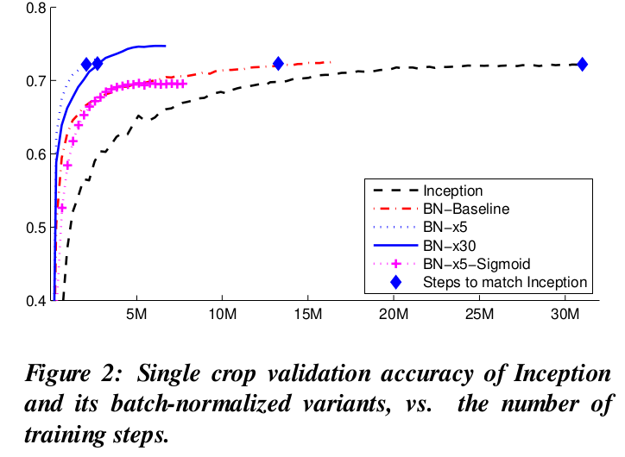
Result:
Figure: the number of training steps required to reach the maximum accuracy of Inception (72.2%)

Slide 18
Limitations
Paper doesn’t talk about limitations in algorithms like RNNs, Online Learning
Performance in small mini batches aren’t discussed.

Slide 19
Thank You!

